Slide 1
A Philosophy on Testing While Coding

Slide 2


Hello!
I AM HOWIE REITH
Software Developer
Howard.Reith@gmail.com

Slide 3
Contents
What inspired me to care about testing?
Test Categories
Purpose of Testing as a Developer
How to Write Tests
TDD Bad Practices

Slide 4
What inspired me to care about testing?
1

Slide 5
What inspired me to care about testing?
Personal Reasons Why I Started to Care:
When I first became a developer, multiple people advised I start in QA Automation, as some of the best devs they knew started that way.
TDD is a widely-admired best practice, advocated by some of the most prominent voices in the Agile movement.
The people I consider to be the five best developers I've ever met are all more enthusiastic about testing than me.
My first job required TDD and I was able to see the benefits first-hand.

Slide 6
Test Categories
2

Slide 7
Test Categories
For our purposes tests comes in three categories:
Unit Tests
Integration Tests
End-to-End Tests
You may also come across the term "static testing." This is basically your linter, spell check, etc.

Slide 8
Test Categories
Unit Tests
Test the functionality of a single component or function.
All dependencies are mocked.
Run very quickly.

Slide 9
Test Categories
Integration Tests
Test interactions between multiple components.
Mocks as few dependencies as possible.
Mocks typically exist at the edges of the application (mocking back end call responses, front end JSON, etc.)
Should run relatively quickly.

Slide 10
Test Categories
End-to-End Tests
Boot up the entire application and simulate expected user behavior.
Last line of defense. As long as these are passing, you guarantee core functionality is present.
Run very slowly. Might be flaky or unreliable.

Slide 11
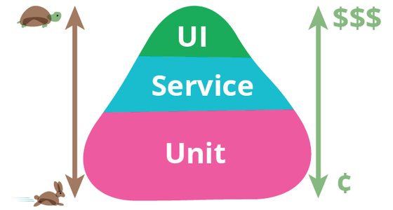
Test Categories
Martin Fowler Test Pyramid

Slide 12
Test Categories
The Truth
These categories are immaterial. What matters is that we've got fast tests, kinda fast tests, and slow tests.
Running the faster tests is practical when developing. We want to be able to run them "every time we save a file." Typically will not run the slow tests until merging to master.

Slide 13
Test Categories
Who Writes the Slow Tests?
The purpose of slow tests is QA.
Debateably, "end-to-end" tests shouldn't be written by developers at all. We are too close to the implementation to write such tests without bias.
They should ideally be written by QA Automation Engineers. If that is not possible, they should ideally at least designed by designers / product managers. "This is the functionality we want to guarantee. Here is how a user would perform this functionality."

Slide 14
Test Categories
Who Writes the Fast Tests?
Fast tests are not there for QA. This is a benefit they provide but not the primary reason to write them.
Fast tests are there to help you and your team.
They are thus written by developers.
Notes:
Writing units tests for QA is like working out to heat a room.

Slide 15
Purpose of Testing as a Developer
3

Slide 16
Purpose of Testing as a Developer
Why write (fast) tests?
Provides confidence that your code works
Speeds up refactoring
Lets your mind move on
Forces modular design
Documentation
Code review and team confidence
Collaboration across time

Slide 17
Purpose of Testing as a Developer
Provides Confidence that your Code Works
If all facets of your interface behave in the way you'd expect, you can have confidence that your program as a whole will behave correctly as well.
Tests let you confirm this is the case at every step.

Slide 18
Purpose of Testing as a Developer
Speeds Up Refactoring
If I have a set of tests verifying that my interface behaves as expected, and if those tests continue to pass after I make changes to the implementation, I can immediately move on.
Without these tests, I would need to manually test every functionality of the interface once again.

Slide 19
Purpose of Testing as a Developer
Lets Your Mind Move On
You can only store so much information in your head.
Coding is complex and hard.
When you've completed a module and it's well-tested, you can relieve your short-term memory of that section of your work. "I can trust this now."
Your mind can now focus on the next module.

Slide 20
Purpose of Testing as a Developer
Forces Modular Design
Unit testing encourages following SOLID principles
Single Responsibility and Interface Segregation - if all my logic is bunched into one monster function/class, writing tests will be difficult and superficial. If I break it into several with single responsibilities, each unit test is simple and clear.

Slide 21
Purpose of Testing as a Developer
Documentation
Unit tests describe intention. "This is what this function does. This is how I expect it to behave."
Unit tests are "alive." When the code changes, if behavior changes, the tests change. This cannot be said of external documentation or code comments.
Unit and integration tests provide context. "This is the sort of data I'm expecting this module to be accepting."

Slide 22
Purpose of Testing as a Developer
Code Review and Team Confidence
If you're reviewing your teammate's code and they have no tests, you need to manually test everything they did.
If they wrote tests, at least for the things they tested, you only need to examine whether those tests are properly testing what they claim to test (and if there is anything that also ought to be tested).
You show your teammates that you thought this through.

Slide 23
Purpose of Testing as a Developer
Collaboration Across Time
Part of the point of code review and paired programming is that when we're collaborating on a project there are things some of us know and others don't.
People leave the company. People forget what they worked on. But tests remain.
Tests let you know when the changes you made broke some part of the code base. No one needs to manually recognize that might be the case.

Slide 24
How to Write Tests
4

Slide 25
How to Write Tests
Test the interface, not the implementation
If your tests are heavily dependent on the internal workings of your module to test, you rob yourself of the freedom to refactor.
Your tests should only interact with the interface. Do not access private methods. Avoid artificially updating state after the test has begun. You should be able to change the code behind your interface, and so long as it achieves the same end, all tests should pass.

Slide 26
How to Write Tests
No test should depend on a previous test
You should be able to run your tests individually. If you cannot, tests will be slower and harder to debug, rendering them incapable of serving their aforementioned purposes.
Each test should begin with whatever setup is necessary for its state to be what it needs to be.
If the test affects global state, a database, or anything else that would affect the functionality of other tests, the test should clean up after itself.

Slide 27
How to Write Tests
Name your tests in an English readable way
Test names (or descriptions if available) should describe precisely what is being tested.
"Multiply_numbers_should_multiply_two_four_digit_numbers" as opposed to "Multiply_numbers_test"
"ParseShakespeareSonnetShouldReturnArrayOfFourteenStrings"

Slide 28
How to Write Tests
Make the line between unit/integration tests blurry
Remember - for our development testing, the main criterion is whether we can run the tests while we're coding. Whether it's unit or integration is academic.
If it makes sense to write a unit test that happens to bring in other components, feel free to do so. Just do not view such integration tests as substitute for units tests of those other components.
This will test more functionality and catch bugs that you missed in your unit tests while still being pretty fast.

Slide 29
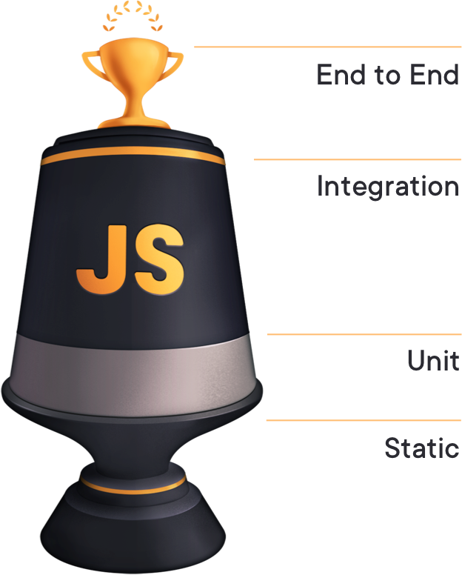
Best Practices

Slide 30
How to Write Tests
Tests should have no external dependencies
No one should be able to ship code if they have failing tests. As such, you should never have any test depending on something over which you have no control.
Example: you have an app that tracks stock prices. You have a test that hits a NYSE api to get data. NYSE API goes down - you can't push code.
Such a test could live as a monitoring tool, but it should not be in your "slow test" suite, let alone your "fast test" suite.

Slide 31
How to Write Tests
Start with a failing test
Start by writing your test in a way that fails.
I typically like to start with "assert true == false"
This guarantees you don't forget about the test or forget to write assertions.
If you already know your requirements for your module, it's also a good practice to start by articulating them in the names of your "assert false" tests. Once you know what you're doing, go back and flesh the tests out.

Slide 32
TDD Bad Practices
5

Slide 33
TDD Bad Practices
Giving too much importance to the "minimum implementation"
One principle in TDD is that, after you write your test, you write the minimum amount of code necessary to make that test pass.
This, taken to it's logical extreme, could lead to making your entire program an endless list of if clauses.
You are a programmer. Remember the end goal is to write elegant interfaces that solve complex problems.

Slide 34
TDD Bad Practices
Writing circular tests to say you wrote a test
In a situation in which your code does not work, your test should fail. While we don't want brittle tests, and we want to be able to freely refactory, we don't want our tests to be invincible.
Make sure your tests are not employing circular logic. Do not mock out the functions you're testing.

Slide 35
Bibliography
Martin Fowler's Testing Page
Kent Dodds unit vs. integration vs, e2e tests
Agile testing a beginner's guide
Google Blog - just say no to more end to end tests
Test Driven Development by Example by Kent Beck

Slide 36
Thanks for watching!
ANY QUESTIONS?
You can contact me at
Howard.Reith@gmail.com

